Slide 1
1960s technology
By joseph Sheehan and Liam waikem

Slide 2
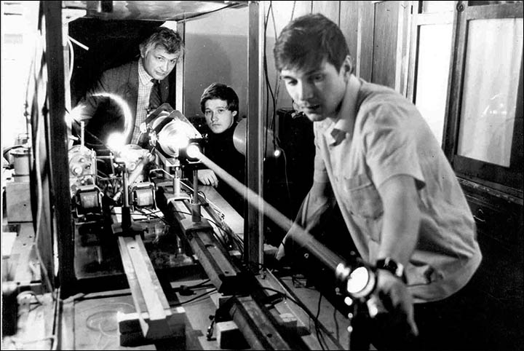
The laser
The laser was created by Theodore Maimen
It was created on May 16, 1961
Laser is an acronym for Light Amplification by Stimulated Emission of Radiation

Slide 3
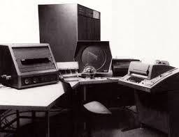
Pdp-1
Was the first mini computer on the market
Was created on November 19, 1961
PDP was short for Programmable data processer
Started the culture of hacking
Contained the hardware for the first game called Spacewar

Slide 4
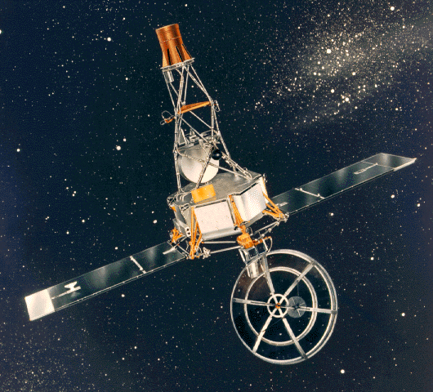
Mariner ii
Satellite that was launched toward Venus
Had a Motorola transmitter on it
The transmitter was added so that Mariner II could communicate with NASA
It also had a microwave on it

Slide 5
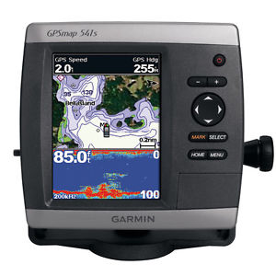
gps
GPS was first made for commercial use on May 21, 1967
Thought up after sputnik was launched
This is because it was confirmed reliable in everyday use

Slide 6
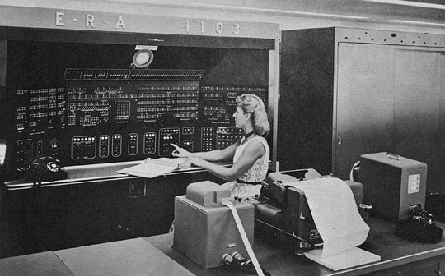
supercomputer
The first supercomputer was created by Semour Crey
Created on August 4, 1969
It was called the CDC 7600

Slide 7
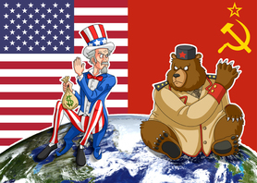
Space race
Soviets launched first satellite giving them the lead
U.S trying to catch up launched Explorer I
Soviets launched Yuri Gagarin the first man in space
Later U.S launches Alan Shepard in Freedom 7, but it was almost a year until John Glenn fully orbited Earth
Soviets kept getting more and more space firsts
NASA turned to one big finish line, THE MOON
Apollo 11 landed on the moon on July 20, 1969
Soviets attempted to land an unmanned satellite on the moon, but they tried to change course and it crashed
2 months later the space race had finished and the U.S won

Slide 8
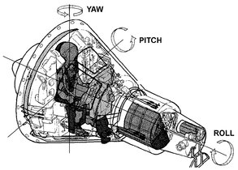
Three axis control
Allowed better stabilization
Enables satellites to move multiple things with precision
Created in early 1960s

Slide 9
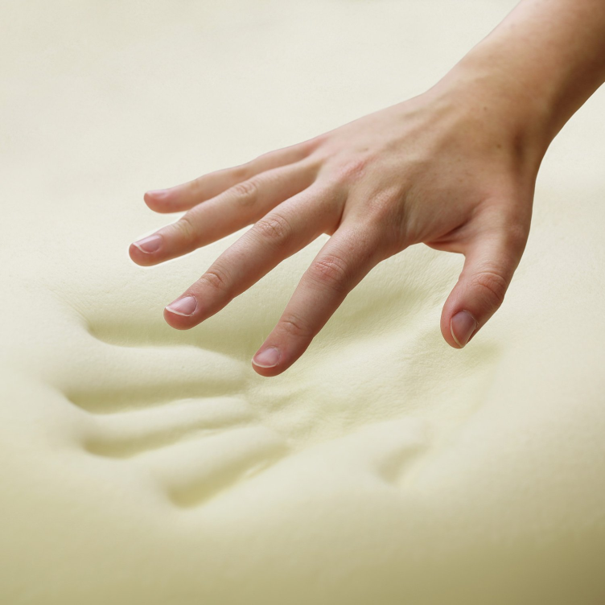
Slow springback foam
Could absorb the energy and pressure of a crash
The foam would eventually return to its shape
Also, made sitting for hours on a long flight more comfortable
Later, the creator, Charles Yost, made his own company and renamed the foam to temper foam

Slide 10
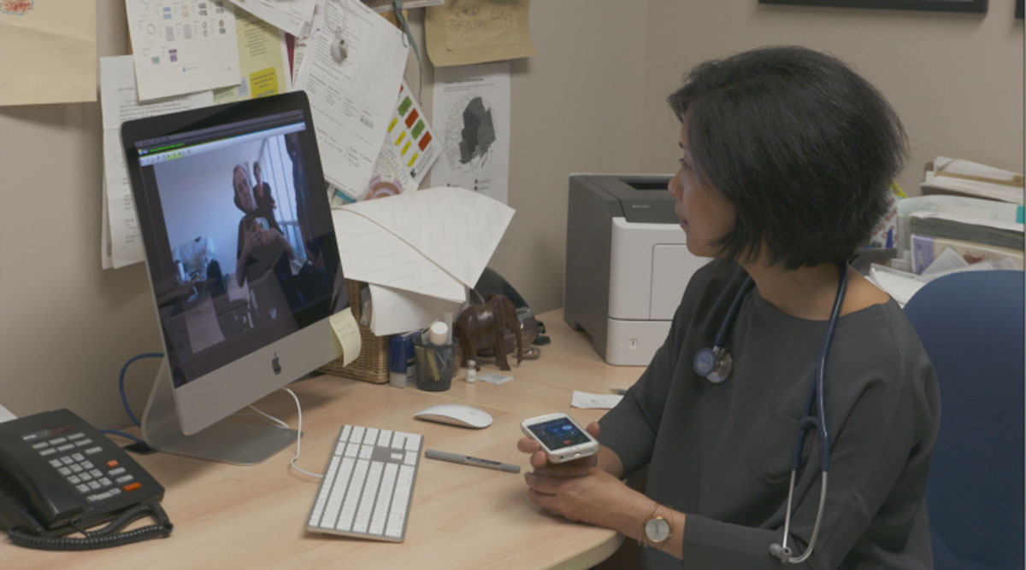
telemedicine
The ability to keep track of an astronauts health remotely was big in the space program
Examples:
Programmable peacekeepers
Blood pressure monitors

Slide 11
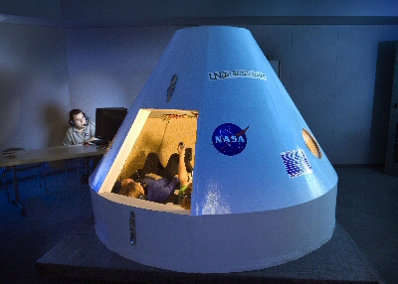
3d graphics and virtual reality
Created to visualize space-based environments here on Earth
An example is a flight simulator
The success of the moon landing was a result of hours upon hours in simulators

Slide 12
Conclusion
As you can see, there were lots of inventions in the 60s. Many of the things we use today, we can thank the 60s for. For instance, video games. They were first made in the 1960s and were used to help astronauts train for space travel. Also, telemedicine was created in the 60s and we use it today to keep track of a persons health. Also, temper foam (which we use for beds) was created in the 60s and used for seats in satellites and shuttles.

